Slide 1
Load Rating of Northampton County Bridge via THMPR
Presented by
Franklin L. Moon, PhD
Principal
Intelligent Infrastructure Systems, LLC
Associate Professor
Drexel University

Slide 2
Presentation Outline
Load Rating Procedures as per the AASHTO Manual for Bridge Evaluation
Overview of the THMPR System
Structural Identification and System Description
Validation of Modal Impact Testing Capabilities
FE Modeling, Model Updating, and Load Rating
Applications to Northampton County Bridges
Summary and Discussion

Slide 3
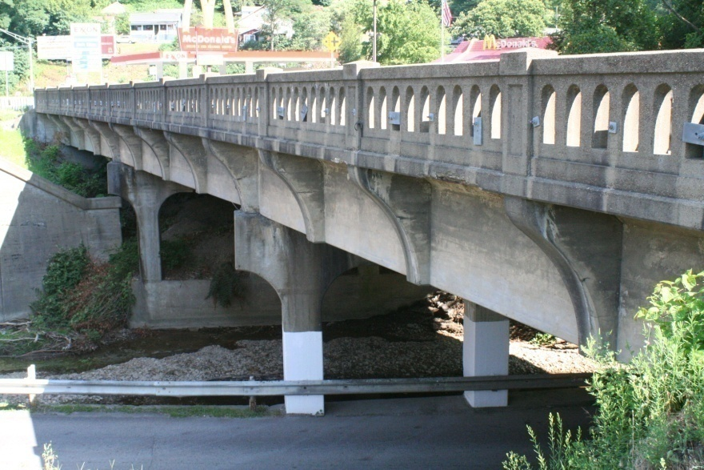
AASHTO Manual for Bridge Evaluation
Analytical Load Rating
Simplified
REFINED
Physical Testing
Engineering Judgment
Dynamic
Static
Driven by visual appearance
Typically lacks appreciation for mechanics
Diagnostic
Proof
Pull-release
Shaker
IMPACT

Slide 4
AAHSTO MBE Relevant Provision
Section 6A.3.
“Permitted Analysis Methods include: approximate methods, refined methods*, and analysis by field testing (load testing).”
*Article 4.4 of the AASHTO LRFD Bridge Design Specification define finite element analyses as a refined method of analysis
Section 6A.3.4
“Bridges may be evaluated by field testing (load testing) if the evaluator feels that analytical approaches do not accurately represent the true behavior and load distribution of the structure and its components.”
Section 8.1.1
“Load testing is the observation and measurement of the response of a bridge subjected to controlled and predetermined loadings without causing changes in the elastic response of the structure.”

Slide 5
AAHSTO MBE Relevant Provision
Section 8.1.2
“A dynamic load test is conducted with time-varying loads or moving loads that excite vibrations in the bridge. Dynamic tests may be performed to measure the modes of vibration, frequencies, dynamic load allowance, and to obtain load history and stress ranges for fatigue evaluation.”
Section 8.4.2.3
“Vibration tests may be conducted by means of portable sinusoidal shakers, sudden release of applied deflections, sudden stopping of vehicles by braking, and impulse devices such as hammers.”

Slide 6
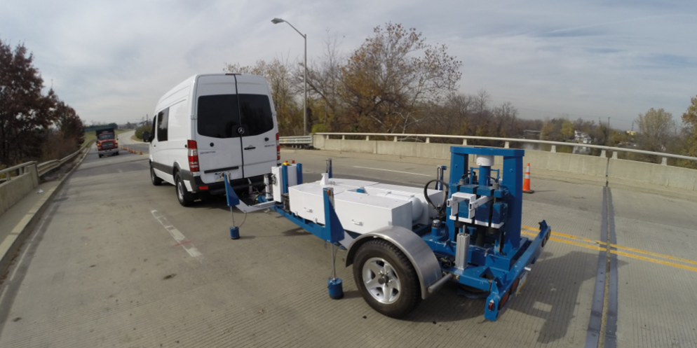
THMPR
(Targeted Hits to Measure Performance Responses)
Step 1
Rapid modal impact testing using a self-contained mobile device
Step 2
Semi-Automated pre- and post-processing to obtain global frequencies and mode shapes
Step 3
Automated FE modeling using NBI data and on-site assessment
Step 4
Automated FE model calibration and load rating
Step 5
Reporting

Slide 7

THMPR
(Targeting Hits to Measure Performance Responses)

Slide 8
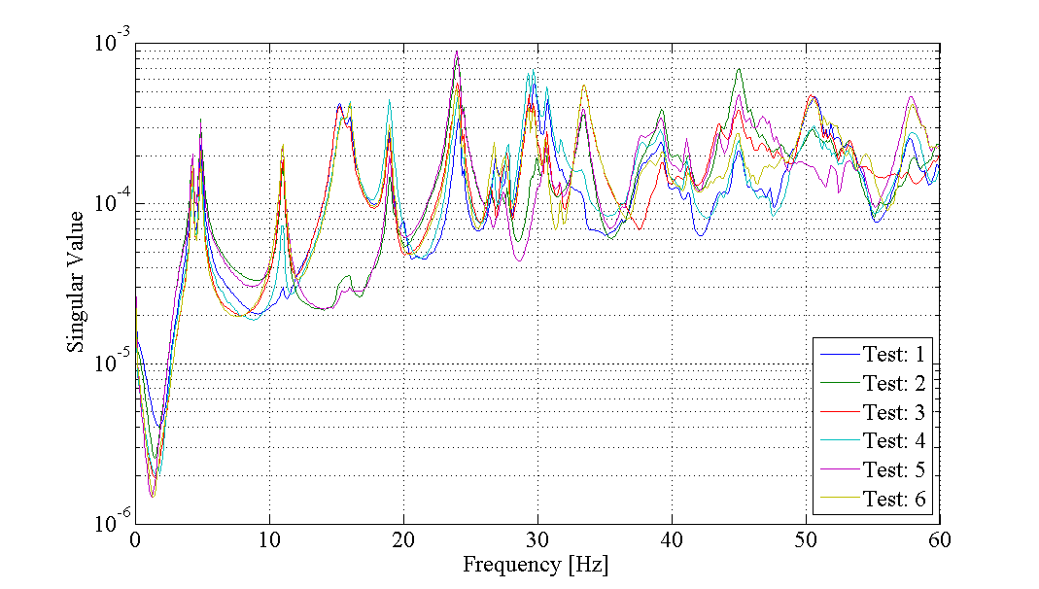
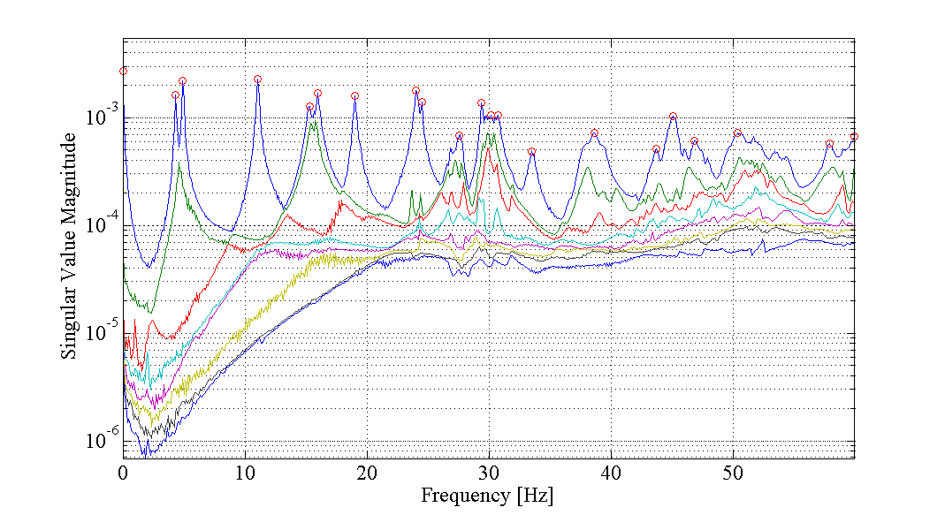
THMPR Comparison with MIMO*
*Best practices approach to modal impact testing
CMIF - THMPR System
Mode | THMPR System [Hz] | MIMO [Hz] | % Diff
1 | 4.289 | 4.327 | -0.88%
2 | 4.873 | 4.909 | -0.73%
3 | 10.996 | 11.049 | -0.48%
4 | 15.229 | 15.204 | 0.16%
5 | 16.018 | 15.944 | 0.46%
6 | 18.971 | 19.001 | -0.16%
7 | 24.018 | 24.099 | -0.34%
8 | 27.508 | 27.631 | -0.45%
9 | 29.404 | 29.379 | 0.09%
10 | 33.454 | 33.491 | -0.11%
1 Mode solved per test
at each frequency line
CMIF – MIMO Sledge
8 Modes solved at each frequency line

Slide 9
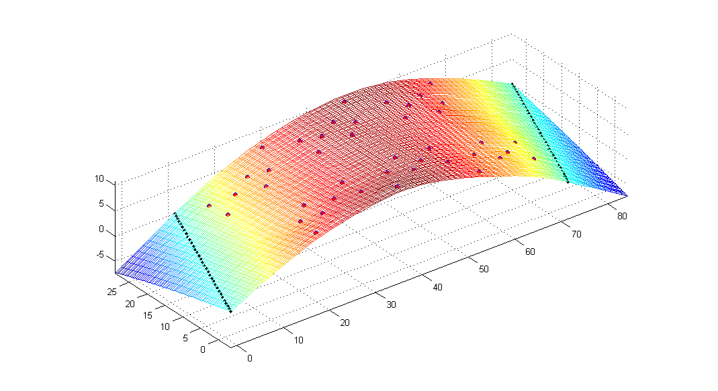
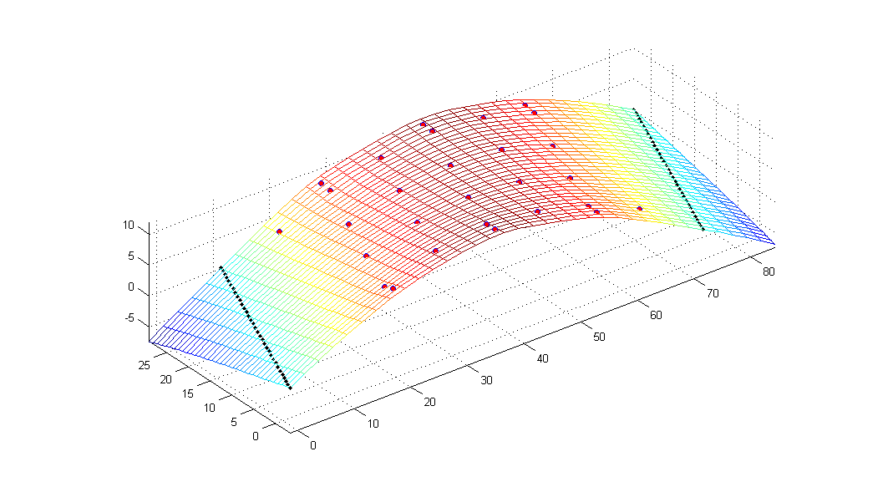
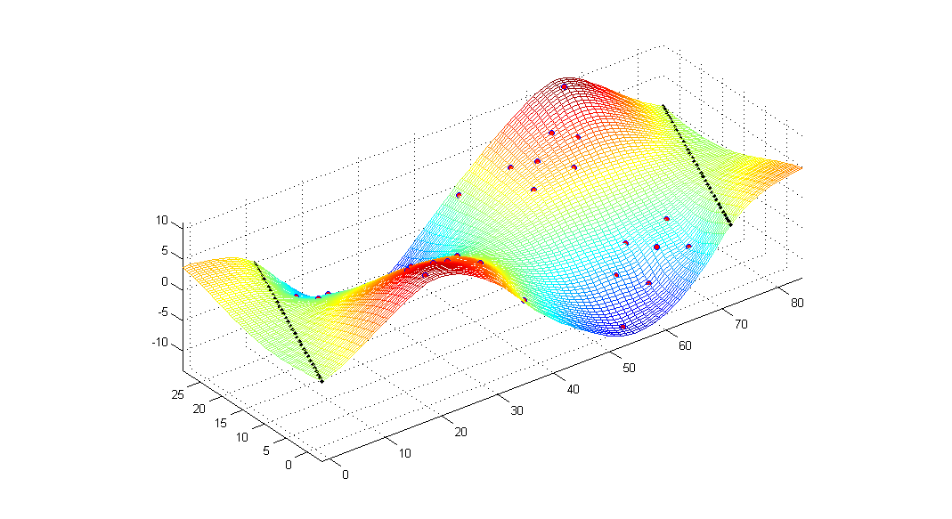
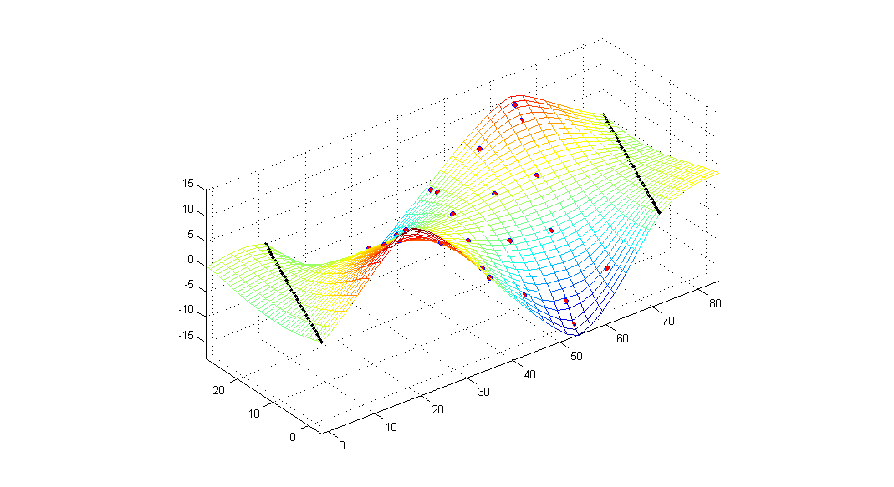
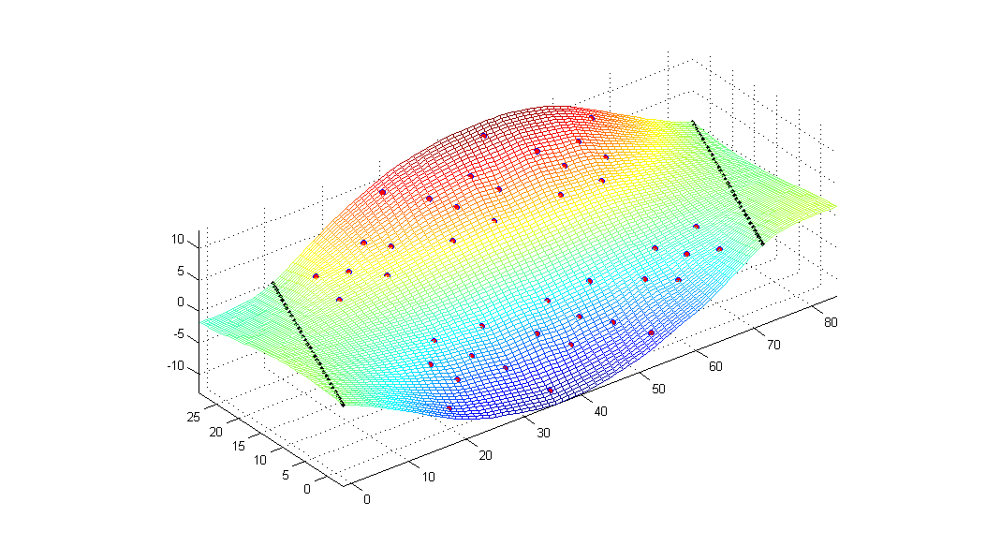
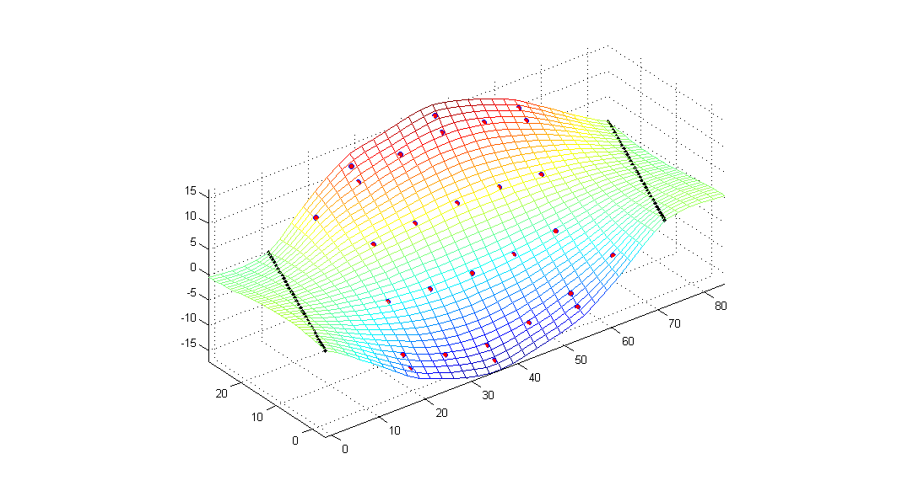
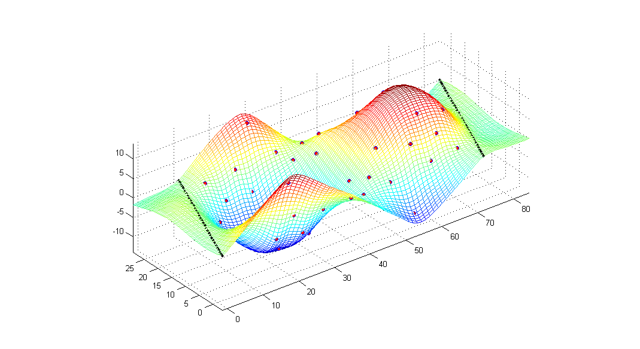
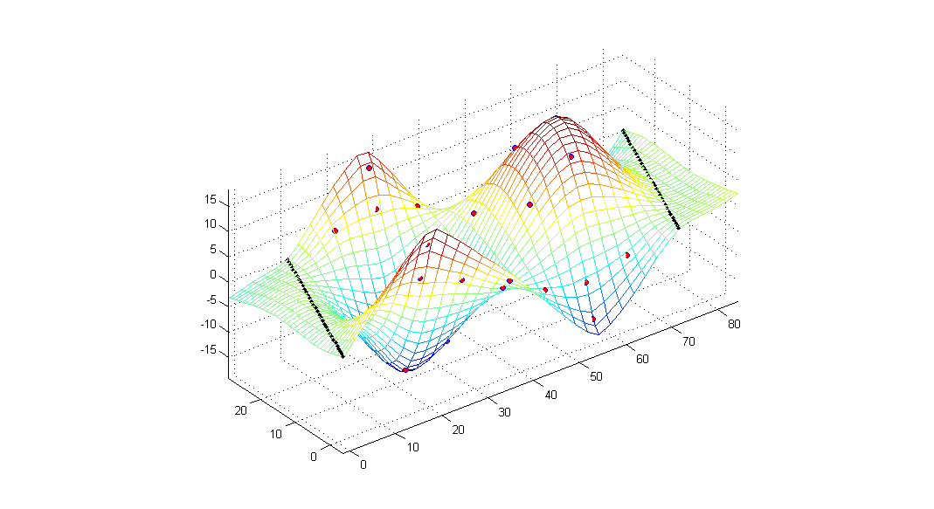
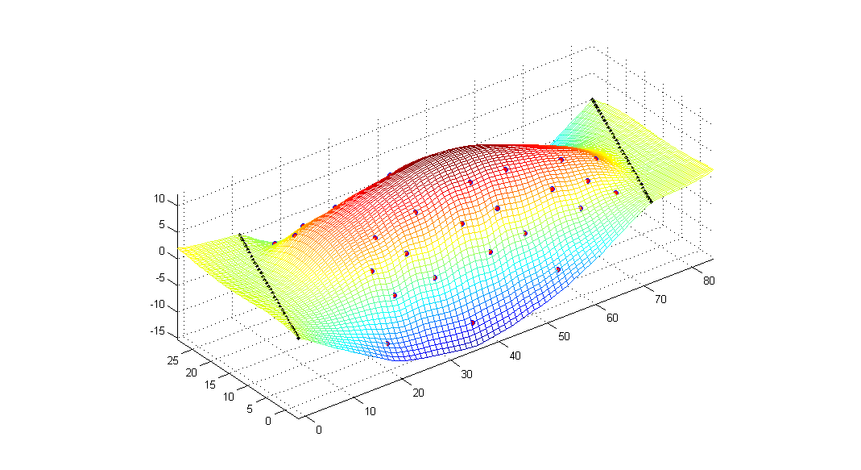
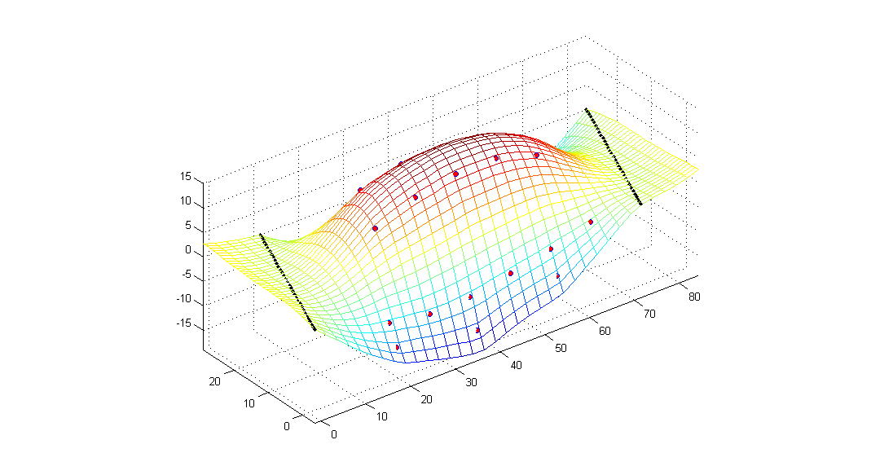
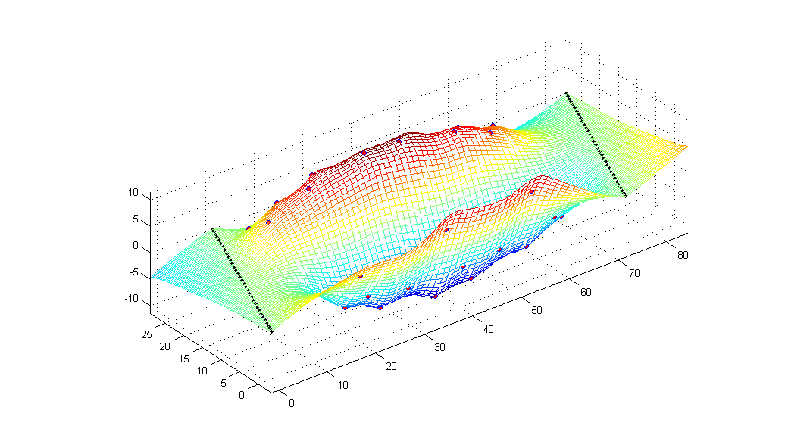
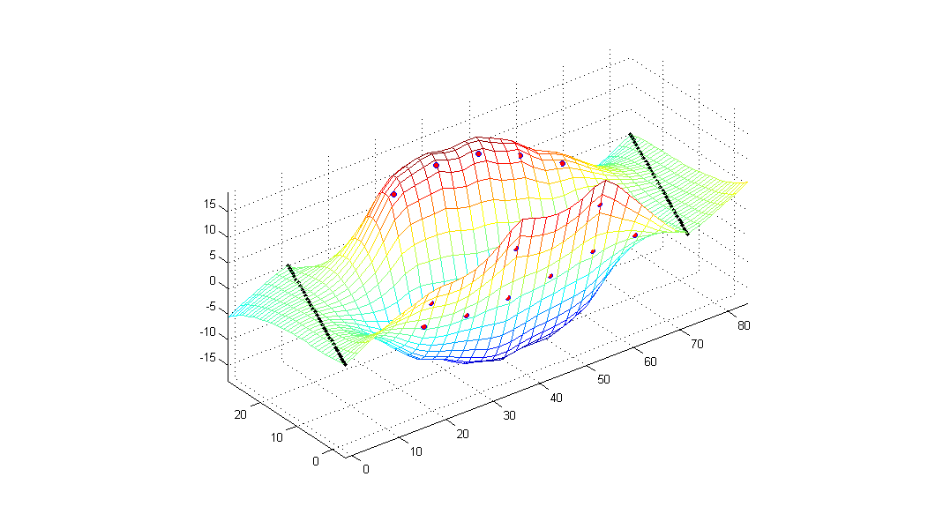
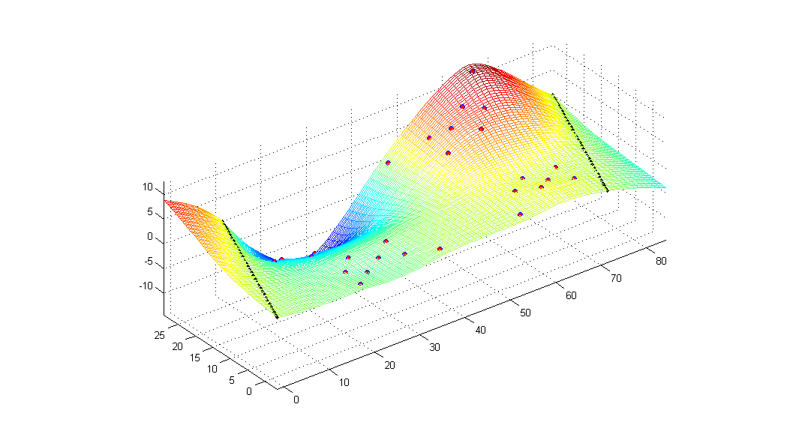
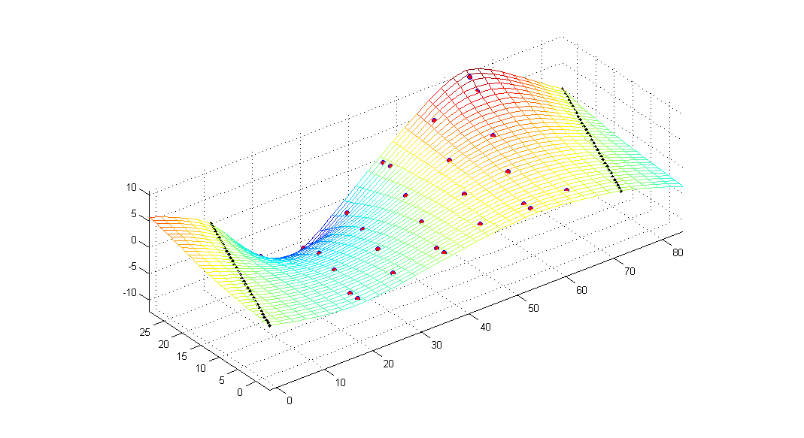
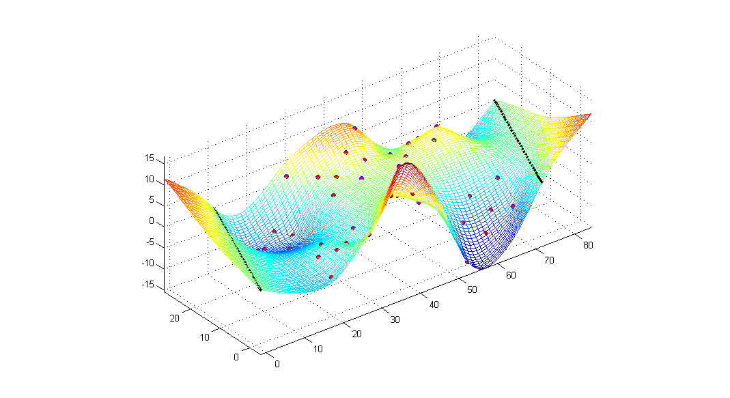
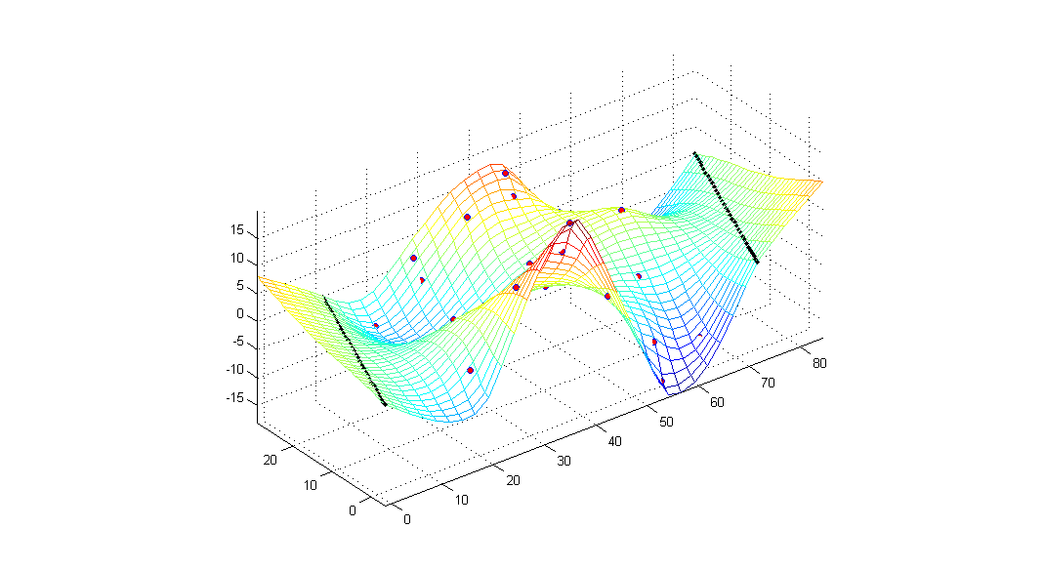
THMPR Comparison with MIMO*
*Best practices approach to modal impact testing
THMPR
VS
MIMO
THMPR
VS
MIMO
Mode 1
Mode 5
Mode 2
Mode 6
Mode 3
Mode 7
Mode 4
Mode 8
| 9

Slide 10
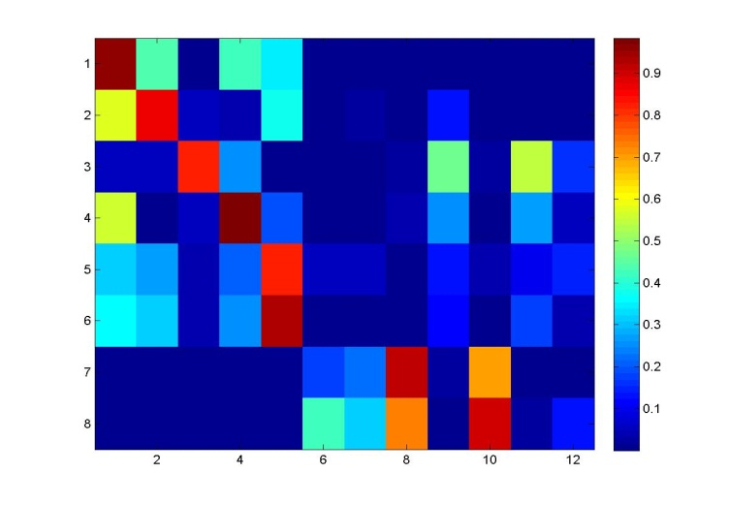
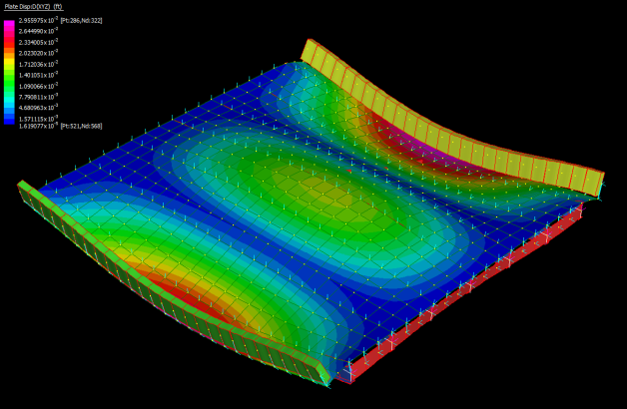
Modeling, Updating, and Rating Approach
Modal Assurance Criterion
Creation of A priori model using design heuristics
Identify uncertain parameters (BC, CC, etc)
Experimental Mode Shapes
Computation of modal parameters
Update uncertain parameters
Comparison to in situ modal testing results
Analytical Mode Shape
Calculate objective function
Ignore mechanisms that may not be reliable long-term
Calculate updated rating factors, distribution factors, etc.

Slide 11
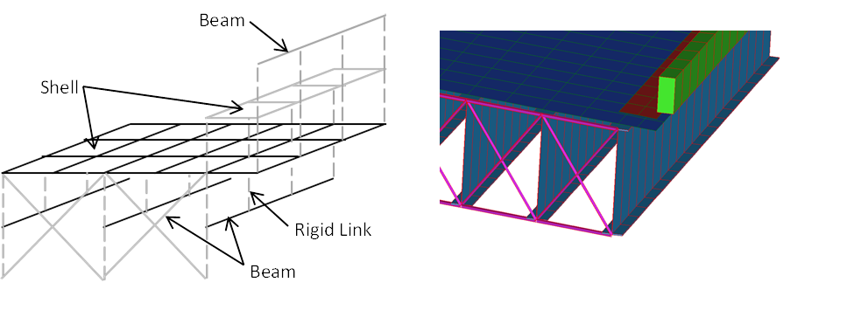
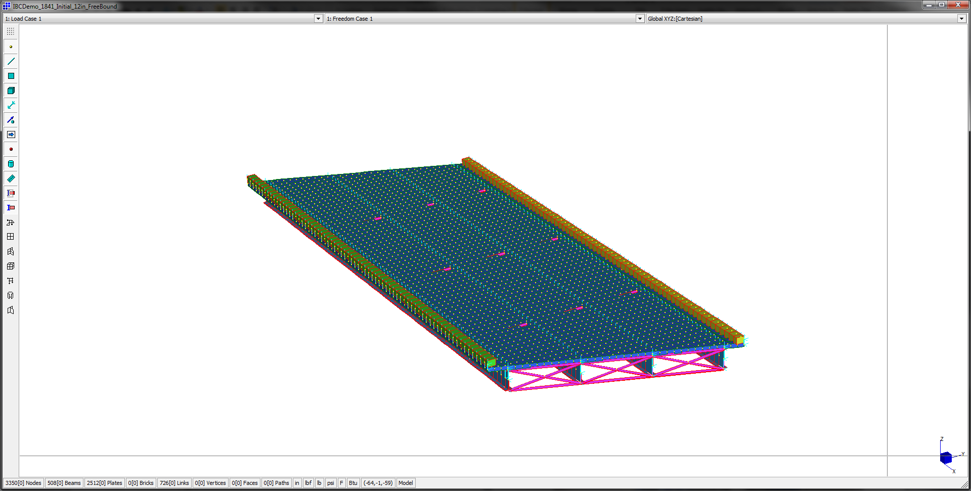
Element-Level FE Modeling Approach
Model approach validated under NCHRP Project 12-103 through:
Mesh sensitivity studies
Comparison with benchmark problems
Comparison with more refined FE modeling approaches

Slide 12
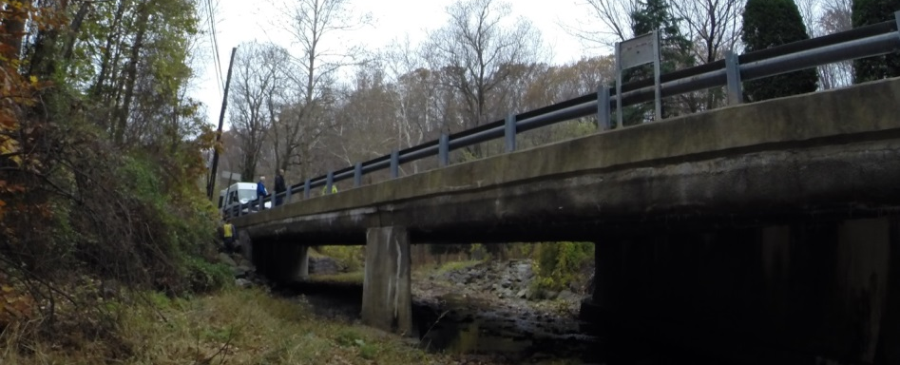


Overview of Northampton Bridges
Bridge 041
Type = Concrete-encase Steel Multi-girder
Configuration = 2 Simple Spans
Max span length = 41.5 ft.
Skew = 60º
Posting = 20 ton
Bridge 063
Type = Concrete-encase Steel Multi-girder
Configuration = 3 Simple Spans
Max span length = 33.5 ft.
Skew = 0º
Posting = 16 ton
Bridge 076
Type = Concrete-encase steel through-girder
Configuration = 1 simple spans
Max span length = 41 ft.
Skew = 0º
Posting = None

Slide 13
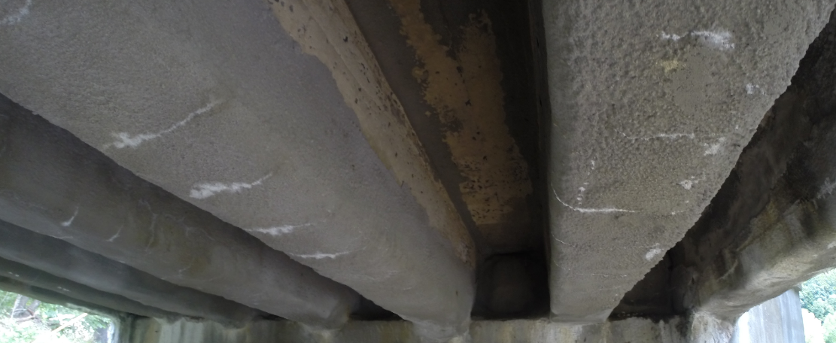
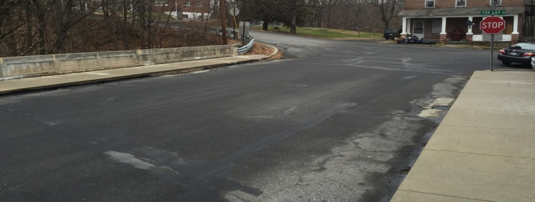
Overview of Northampton Bridges
Bridge 138
Type = Concrete-encase steel multi-girder
Configuration = 1 simple spans
Max span length = 49 ft.
Skew = 0º
Posting = 20 ton
Bridge 200
Type = Concrete-encase steel multi-girder
Configuration = 1 simple span
Max span length = 45.8 ft.
Skew = 18º
Posting = 30 ton

Slide 14
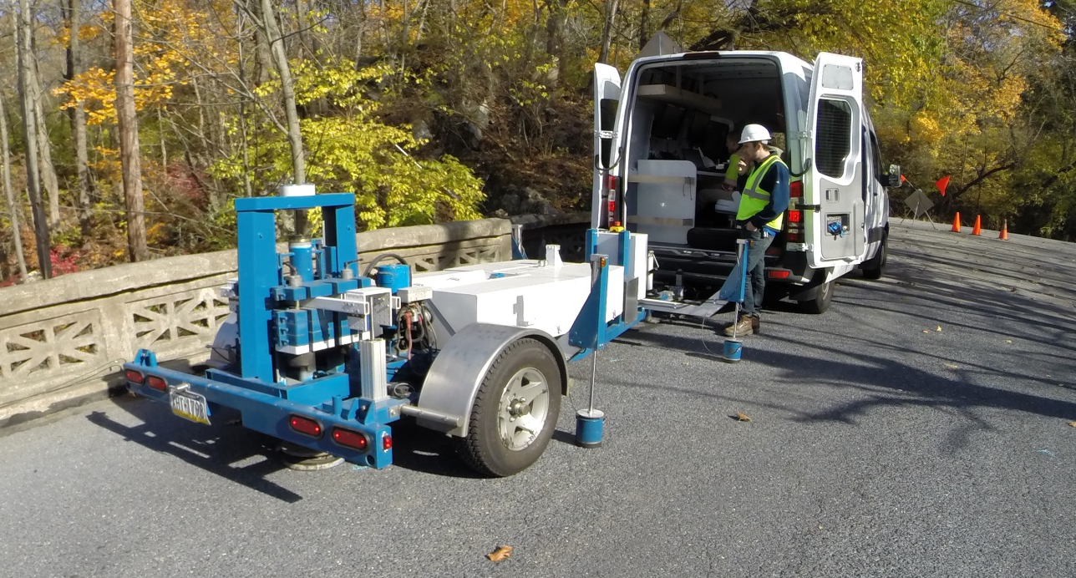
Test Execution
Bridge Number | Test Date | Test Duration
041 | Nov 5 | ~ 60 min
063 | Nov 4 | ~ 90 min
076 | Nov 4 | ~ 30 min
138 | Sept 8 | ~ 30 min
200 | Nov 5 | ~ 30 min

Slide 15
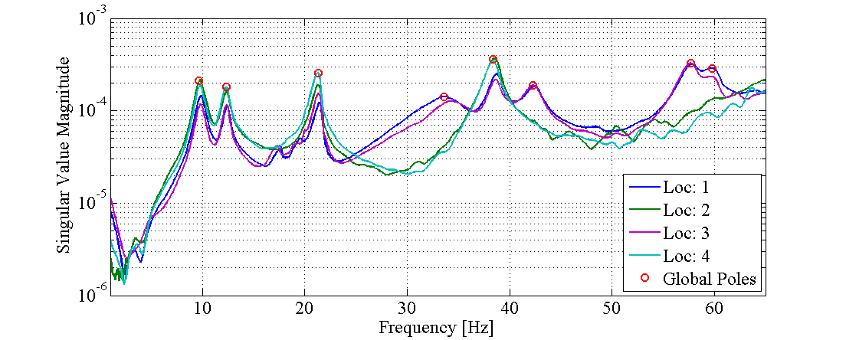
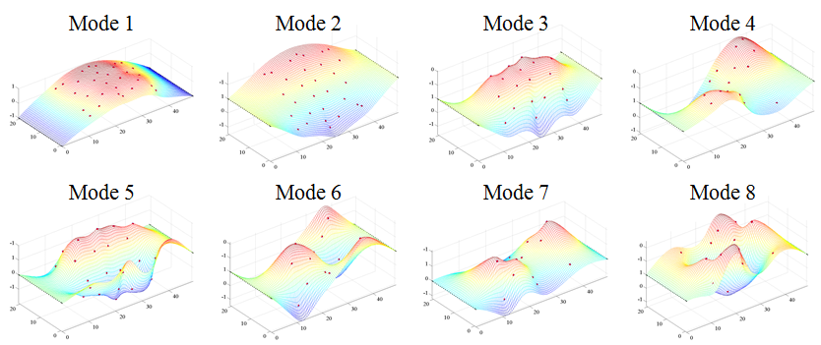
Sample Data and Identified Mode Shapes
(Bridge 200)

Slide 16
Key FE Modeling and Rating Assumptions
Concrete encasement, concrete barriers, and bearing restraints are included during updating, but neglected during load rating
Bridges 041, 063, and 138 – FE models were constructed from information included in previous load-rating reports developed by STV Inc.
Bridge 076 –
Global dimensions were obtained through on-site measurements
All live loads and dead load of the wearing surface was assumed to be resisted by the concrete encasement
Steel girders were assumed to only carried the dead load of the concrete deck and concrete encasement
Bridge 200 –
Steel girder dimensions were estimated through reverse engineering the bridge
This process assumed an H-15 design truck and an allowable stress design methodology

Slide 17
Summary of Load Rating Results (Strength I)
 |  | A -Priori |  | Updated Model w/ Composite Action |  | Updated Model w/o Composite Action
 |  | Inv | Op | Inv | Op | Inv | Op
Bridge 041 | Span 1 | 3.42 | 4.44 | 3.28 | 4.25 | 2.62 | 3.40
 | Span 2 | 3.42 | 4.44 | 3.74 | 4.85 | 2.77 | 3.58
Bridge 063 | Span 1 | 1.25 | 1.62 | 1.23 | 1.60 | 0.81 | 1.06
 | Span 2 | 1.25 | 1.62 | 1.33 | 1.73 | 0.93 | 1.21
 | Span 3 | 1.25 | 1.62 | 1.33 | 1.72 | 0.93 | 1.2
Bridge 076 | - | N.A. | N.A. | > 1* | > 1* | N.A. | N.A.
Bridge 138 | - | 1.63 | 2.11 | 1.71 | 2.22 | 1.10 | 1.42
Bridge 200 | - | 1.56 | 2..02 | 1.67 | 2.17 | 1.04 | 1.35
* Strength I rating based on flexural tensile concrete cracking

Slide 18
AASHTO Manual for Bridge Evaluation
Analytical Load Rating
Simplified
REFINED
Physical Testing
Engineering Judgment
Dynamic
Static
Driven by visual appearance
Typically lacks appreciation for mechanics
Diagnostic
Proof
Pull-release
Shaker
IMPACT

Slide 19
Summary
THMPR System produces load ratings via FE models calibrated to measured vibration frequencies and mode shapes
The process employed by THMPR was placed within the context of the load rating procedures presented by the AASHTO Manual for Bridge Evaluation
Applications to five bridges in Northampton County were presented and the results indicted that all bridges rate for the Strength I Limit State (Op) within the AASHTO LRFR methodology (even if composite action is neglected)
Validation efforts thus far have aimed at (1) comparison with ‘best practices’ modal impact testing procedures, and (2) ‘best practices’ FE modeling approaches

Slide 20
Discussion Points
Additional information (theory or application-related) necessary to answer questions or allay concerns regarding the implementation of THMPR
Typical quality assurance and checking procedures required by PennDOT for load ratings produced via refined analysis and/or load testing
Comments or concerns related to the specific modeling and load rating assumptions employed for the five Northampton County Bridges.

Slide 21
Load Rating of Northampton County Bridge via THMPR
Presented by
Franklin L. Moon, PhD
Principal
Intelligent Infrastructure Systems, LLC
Associate Professor
Drexel University

Slide 22

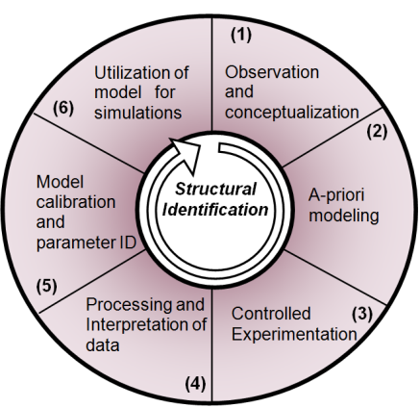
State-of-the-Art – Bridge Capacity Est.
6
1
Load Ratings, Scenario Analyses, Vulnerability Assessment, Retrofit Evaluation…
Document Review, Site Visits, Inspection, Material Sampling…
7
5
2
Heuristic Knowledge
Automated Parameter ID
Bayesian Model Updating…
Model Type Selection
Sensitivity Studies
Measurement Predictions
Instrumentation Design…
Design and implementation of Structural Health and Performance Monitoring Systems
4
3
Data Processing (Filtering, Averaging), Linearity and Repeatability, Experimental Data Processing…
Multi-Modal Instrumentation
Static/Crawl-speed Truck Testing
Environmental Monitoring
Dynamic Testing…

Slide 23
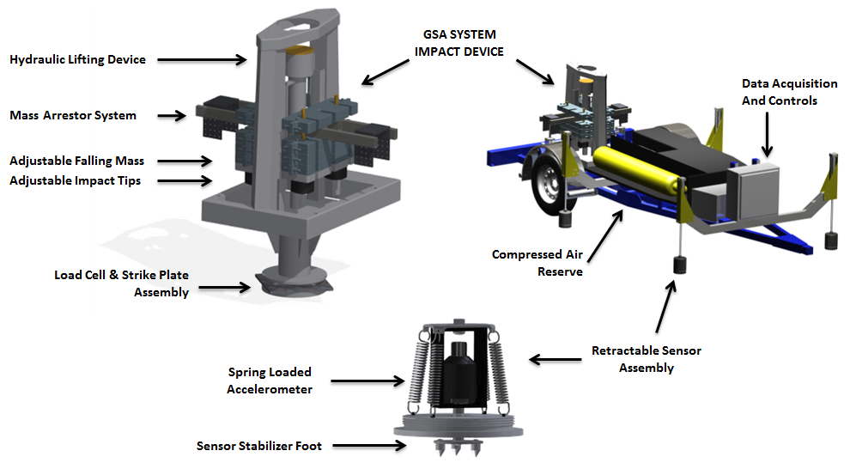
THMPR Components

Slide 24
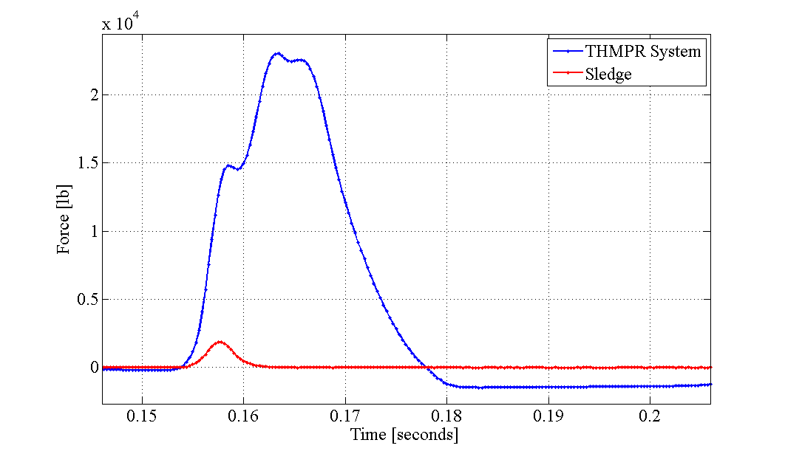
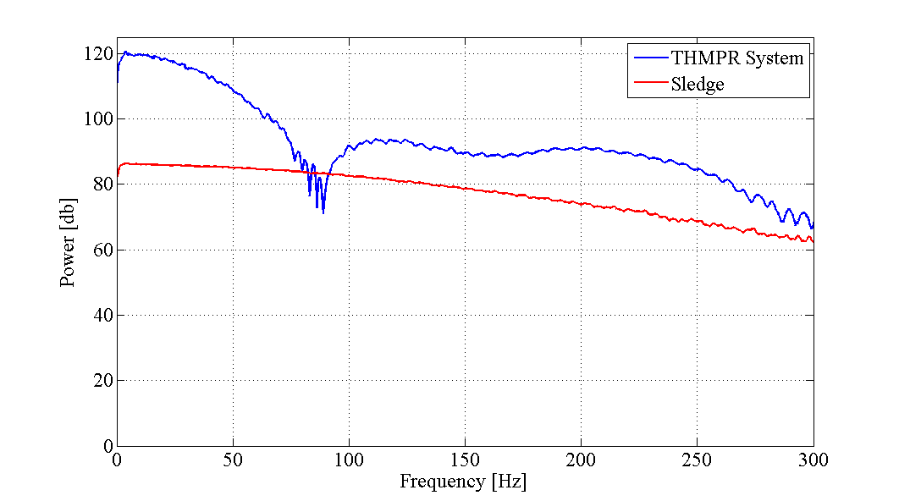
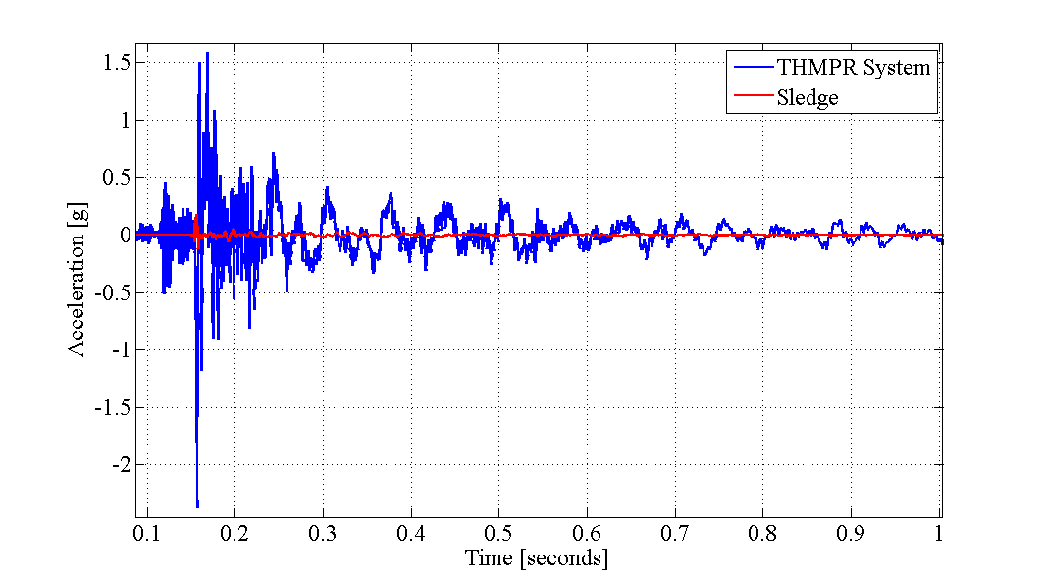
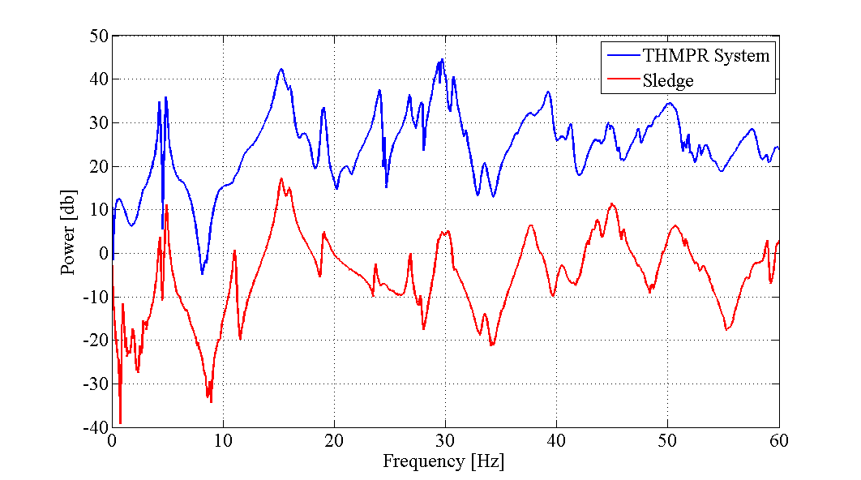
THMPR Comparison with MIMO
25,000lb
3,000lb
~60Hz
~250Hz
.25g
2.5g

